Slide 1
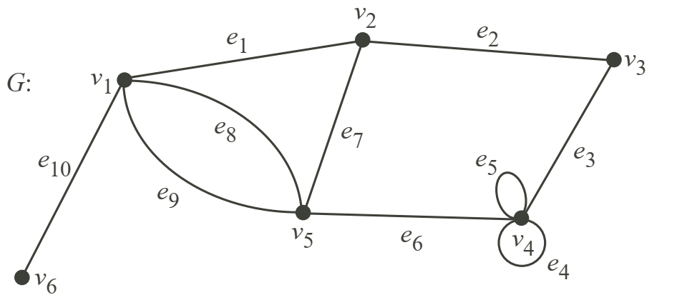
Basics of Graph Theory
Walks, Trails, Paths, Circuits
In a graph G = (V, E)
1. Walks
A walk is a continuous sequence of edges connecting two vertices. k is the length of the walk
Example: v2, e7, v5, e8, v1, e8, v5, e6, v4, e5, v4, e5, v4 is a walk.
2. Trails
A trail is a walk with no repeated edges.
Example: v1, e8, v5, e9, v1, e1, v2, e7, v5, e6, v4, e5, v4, e4, v4 is a trail
3. Paths
A path is a trail with no repeated vertices.
Example: v2, e7, v5, e6, v4, e3, v3 is a path
4. Circuit (or Cycle)
A circuit is a closed trail which is : not empty, the initial vertex = the terminal vertex
If it’s also a closed path (no repeated vertices except the start/end), it’s called a simple cycle.
Example: v2, e7, v5, e6, v4, e3, v3, e2, v2 is a simple circuit

Slide 2
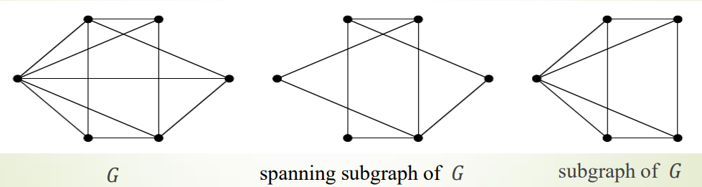
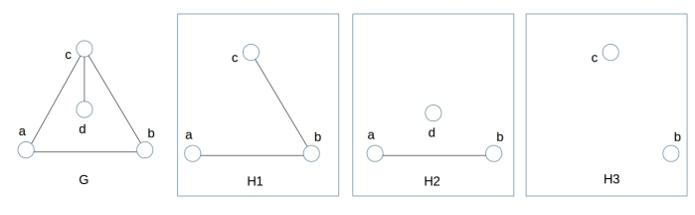
Basics of Graph Theory
Subgraphs, Spanning Subgraph, Induced Subgraph
1. Subgraphs
A graph 𝐻(𝑉1, 𝐸1) is said to be a subgraph of a graph 𝐺(𝑉, 𝐸) if 𝑉1 ⊆ 𝑉 and 𝐸1 ⊆ 𝐸.
2. Spanning Subgraph
A graph 𝐻(𝑉1, 𝐸1) is said to be a spanning subgraph of a graph 𝐺(𝑉, 𝐸) if 𝑉1 = 𝑉 and 𝐸1 ⊆ E.
3. Induced Subgraph
A subgraph that contains every allowable edge between its vertices is called an induced subgraph
Which subgraph is an induced subgraph?
Notes:
Induced Subgraph
Once you pick the vertex set S, the edges in the induced subgraph are fixed — you must include all edges between those vertices that exist in the original graph.
You do not get to choose which edges to include — if they exist in G, they must be included.

Slide 3
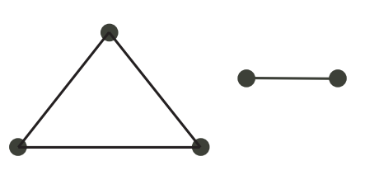
Basics of Graph Theory
Connection, Components (Undirected Graph)
1. Connection
The walk (u,v) start at node u and end at node v.
Two vertices 𝑢 and 𝑣 are said to be connected if there exists a walk between them.
If u and v are connected (there is a walk (u,v)) and v and w are connected (there is a walk (v,w) ), then u and w are also connected (there is also a walk (u,w) ).
A graph is connected if all the vertices are connected to each other
Example. This graph is not connected.

Slide 4
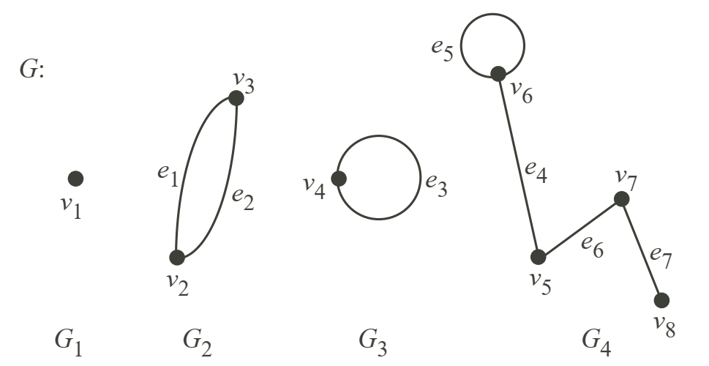
Basics of Graph Theory
Connection, Components (Undirected Graph)
2. Components
A component is a connected subgraph G1 (not null) of the graph that is isolated from the rest (Inside each component, vertices are mutually reachable).
No additional vertex from the graph can be added without breaking that Connectivity .
Between components, there are no connections (no shared nodes or shared edges)
G is connected if it has only one connected component (the whole graph is one component).
Example: The components of G are G1, G2, G3 and G4.

Slide 5
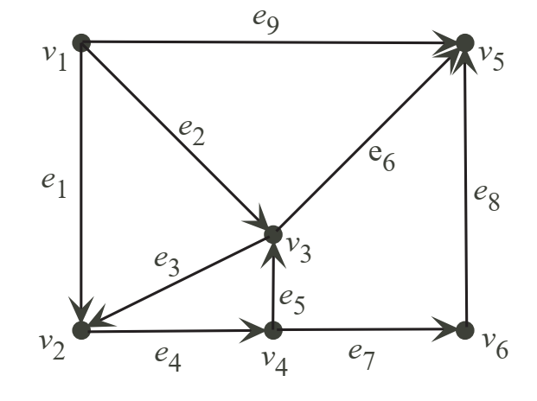
Basics of Graph Theory
Connection, Components (Directed Graph or digraph)
a digraph is formed by vertices connected by arcs (directed edges )
1. Connection
Vertices u and v are strongly connected if there is in G:
  a directed walk (u,v) from u to v
  and also a directed walk (v,u) from v to u
Digraph G is strongly connected if every pair of vertices is strongly connected. By convention, the trivial graph is strongly connected.

Slide 6
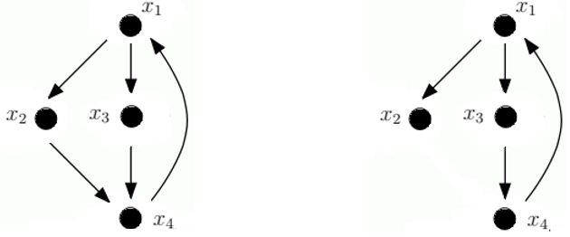
Basics of Graph Theory
Connection, Components (Directed Graph or digraph)
2. Components
A strongly connected component H of the digraph G is:
a directed subgraph of G such that H is strongly connected,
if we add any node or arc from G to H, the resulting subgraph is no longer strongly connected.
a digraph G is strongly connected if it has only one strongly connected component (the whole graph is one component).
Example: strongly connected or not?

Slide 7
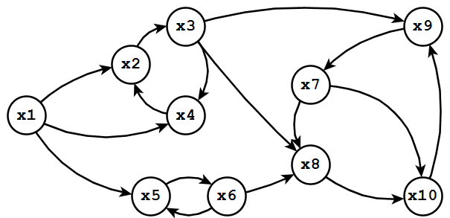
Basics of Graph Theory
Connection, Components (Directed Graph or digraph)
2. Components
The strongly connected components are:
  G1 = ( V={v1}, E= ∅),
  G2 = ( V={v2, v3, v4}, E= {e3, e4, e5}),
  G3 = ( V={v5}, E= ∅) and
  G4 = ( V={v6}, E= ∅).
Example: find the strongly connected components of:

Slide 8
Basics of Graph Theory
Finding the strongly connected components a Digraph
1. Example of use
When designing a communication network, knowing whether the chosen configuration allows communication from any point to any other may be interesting.
One way to check this is to represent the network as a graph and verify if it is strongly connected.

Slide 9
Basics of Graph Theory
Finding the Strong Components of a Digraph
2. Finding a strongly connected component from a vertex v :
Step 1: Traverse the graph from a vertex v in the direct direction:
Create the first set X1 (groups the vertices accessible from v)
Step 2: Traverse the graph from a vertex v in the indirect direction:
Create the second set X2 (groups the vertices they can reach v)
Step 3: The intersection of the two sets gives the vertices that both can reach v and are reachable from v
This intersection X= X1 ∩X2 is therefore the strongly connected component that contains v

Slide 10
Basics of Graph Theory
Finding the Strong Components of a Digraph
2. Finding a strongly connected component from a vertex v :
Algorithm 1
Begin
    Mark v by +/-
    On all vertices not marked by +/− :
        X1 = Mark by + any vertex successor of a vertex marked by +
        X2 = Mark by − any vertex predecessor of a vertex marked by –
    X = any vertex marked by +/−
END

Slide 11
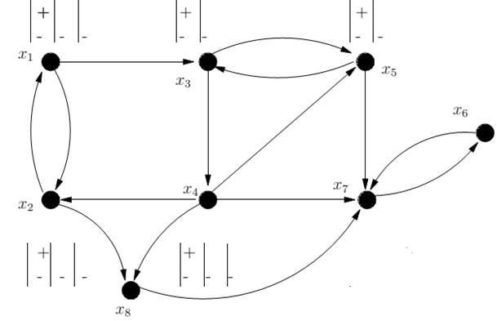
Basics of Graph Theory
Finding the Strong Components of a Digraph
3. Example of finding a strongly connected component from a vertex v :
Beginning
Mark v by +/-
On all vertices not marked by +/− :
    X1 = Mark by + any vertex successor of a vertex marked by +
    X2 = Mark by − any vertex predecessor of a vertex marked by –
X = any vertex marked by +/−
END

Slide 12
Basics of Graph Theory
Finding the Strong Components of a Digraph
4. Finding all strongly connected components :
Step 1: randomly choose a vertex v and determine, using the previous algorithm, the strongly connected component that contains v.
We obtain the first strongly connected component C1.
Step 2: among the vertices not part of C1, we randomly take another vertex x to determine the strongly connected component that contains x.
We obtain the second strongly connected component C2.
Step 3: we repeat until all vertices belong to a strongly connected component.

Slide 13
Basics of Graph Theory
Finding the Strong Components of a Digraph
4. Finding all strongly connected components :
Algorithm 2
Input: G=(V, E) a graph. Output: C={ C1,…,CN } a set of strongly connected components.
Intermediate variables : X': a subset of vertices, x : a vertex, i an integer .
Begin
  X' ← V ; i ← 1 ;
  While ( X'≠ ∅ ) do
    choose x in X' ;
    Ci ← algo1_StronglyConnectedComponent(G,x );
    X' ← X' – Ci ;
    i ← i + 1 ;
  EndWhile
End

Slide 14
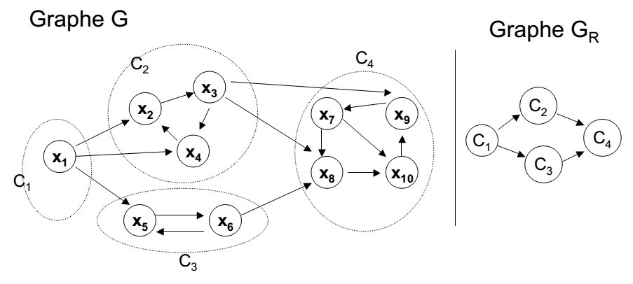
Basics of Graph Theory
Finding the Strong Components of a Digraph
5. Example of finding all strongly connected components :

Slide 15
Basics of Graph Theory
Finding the Strong Components of a Digraph
6. The condensed graph :
The condensed graph Gc of the digraph G is obtained by contracting all the arcs in every strongly connected component.
Each component strongly connected of G is replaced by a vertex

