Slide 1
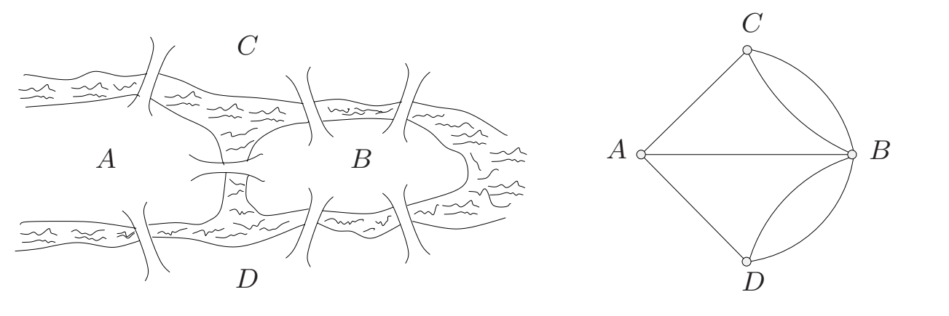
Basics of Graph Theory
Euler tours
1. The Origin of the Problem
Euler showed that it was impossible to cross each of the seven bridges of Konigsberg once and only once during a walk through the town.
2. The solution in graph theory
Let us call a closed walk in a graph an Euler tour if it traverses every edge of the graph exactly once.
A graph is Eulerian if it admits an Euler tour (a closed Euler trail)

Slide 2
Basics of Graph Theory
Euler tours
3. Theorem of Euler
A connected graph is Eulerian (a closed trail): if and only if every node has an even degree.
A connected graph is Semi-Eulerian (an open trail): if exactly two nodes have an odd degree, while all other nodes have an even degree.
The Königsberg problem becomes: does the graph have an Eulerian tour?
Euler's theorem allows us to answer no
since there are 4 vertices odd.

Slide 3
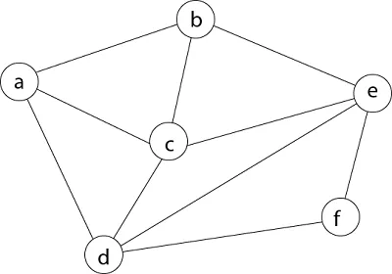
Basics of Graph Theory
Hamiltonian Graph
A connected graph is Hamiltonian: if the graph has a Hamiltonian circuit.
A Hamiltonian circuit visits all the nodes of a graph exactly once
To determine whether or not a given graph has a Hamiltonian circuit is much harder than deciding whether it is Eulerian. It is classified as NP-complete, meaning there is no known efficient algorithm to solve it for all possible instances.

Slide 4
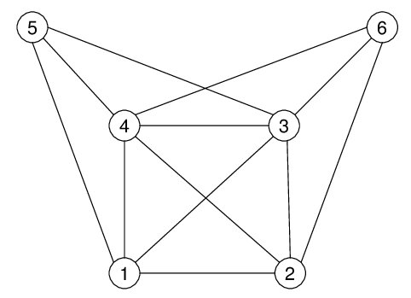
Basics of Graph Theory
Cliques, Stable Sets and Kernels
1. Cliques
A clique is a subset of nodes where every node is directly connected to every other node in the subset.
A complete subgraph of G is called a clique
Example: find the cliques?

Slide 5
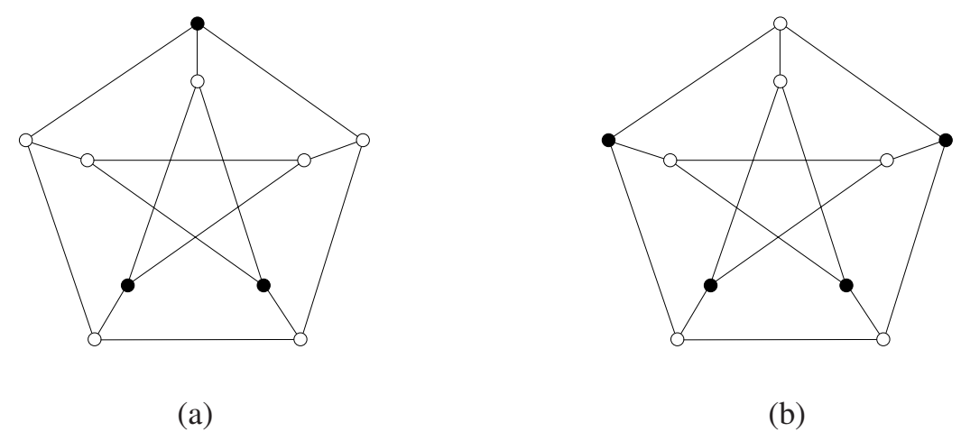
Basics of Graph Theory
Cliques, Stable Sets and Kernels
Stable Sets
a stable set in a graph is a set of vertices where none are adjacent.
Stable sets are also commonly known as independent sets
A stable set in a graph is :
  maximum if the graph contains no larger stable set
  maximal if the set cannot be extended to a larger stable set
a maximum stable set is necessarily maximal, but not conversely.
The cardinality of a maximum stable set is called the stability number and denoted by α(G).
(a) maximal stable set, (b) maximum stable set

Slide 6
Basics of Graph Theory
Cliques, Stable Sets and Kernels
Kernels in Undirected Graphs:
A kernel in an undirected graph is a set of nodes that is both:
Independent (means stable, no edges between vertices in the set) and
Dominating (every vertex not in the kernel is adjacent to a vertex in the kernel).
Kernels in Digraphs:
A kernel in a directed graph is a set of nodes that is:
Independent (means stable, no directed edges between vertices in the set), and
Dominating (every vertex not in the kernel has an out-neighbor arc in the kernel).
Not all graphs have kernels.

Slide 7
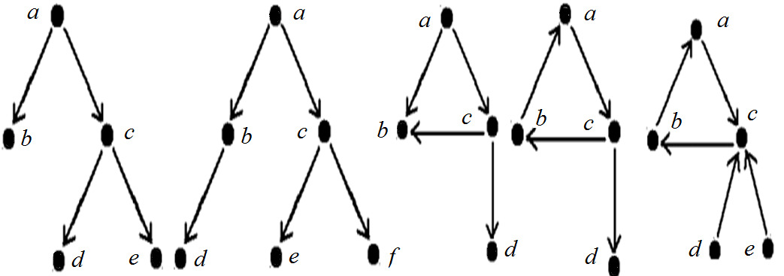
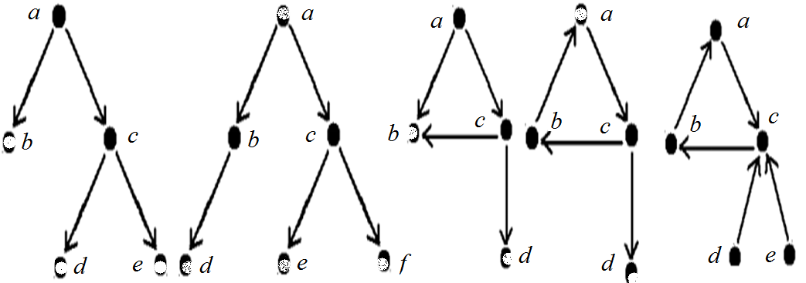
Basics of Graph Theory
Cliques, Stable Sets and Kernels
Kernels:

Slide 8
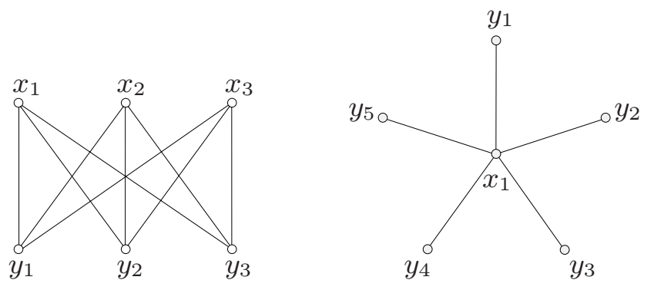
Basics of Graph Theory
Special Families of Graphs
1. Complete graph
is a simple graph in which any two vertices are adjacent
2. Empty graph
no two vertices are adjacent (the edge set is empty)
3. Bipartite graph
If its vertex set can be partitioned into two subsets X and Y, and every edge has one end in X and one end in Y.
(X, Y) is called a bipartition of the graph, and X and Y are its parts.
We denote a bipartite graph G with bipartition (X, Y) by G[X, Y].
If G[X,Y] every vertex in X is joined to every vertex in Y, then G is called a complete bipartite graph.
A star is a complete bipartite graph G[X, Y] with |X| = 1 or |Y | = 1.
A bipartite graph has no odd cycles (odd number of edges).

Slide 9
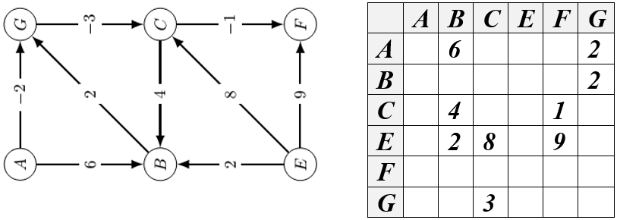
Basics of Graph Theory
Special Families of Graphs
4. Planar graph
Sometimes, in representing graphs by diagrams, we do not allow an edge to intersect itself, nor let an edge pass through a vertex that is not an end of the edge.
We call it a planar graph when the graph can be drawn in the plane in such a way that edges do not intersect.
  All graphs with less than 5 vertices are planar.
  All bipartite graphs with less than 6 vertices are planar.
  For others, there are algorithms to determine whether a graph can be planar or not.
Application example: design of electrical circuits
5. Weighted graph (valued graph)
We call it a weighted graph if a numerical value or weight is assigned to each edge.
This weight can represent various quantities, such as: Distance, Cost, Capacity, …

Slide 10
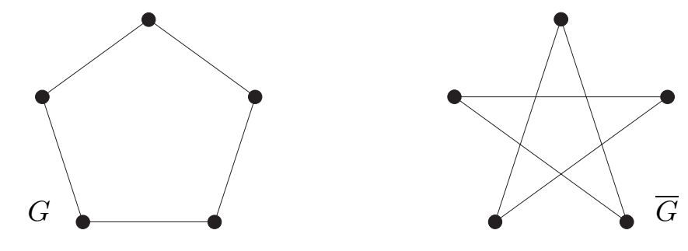
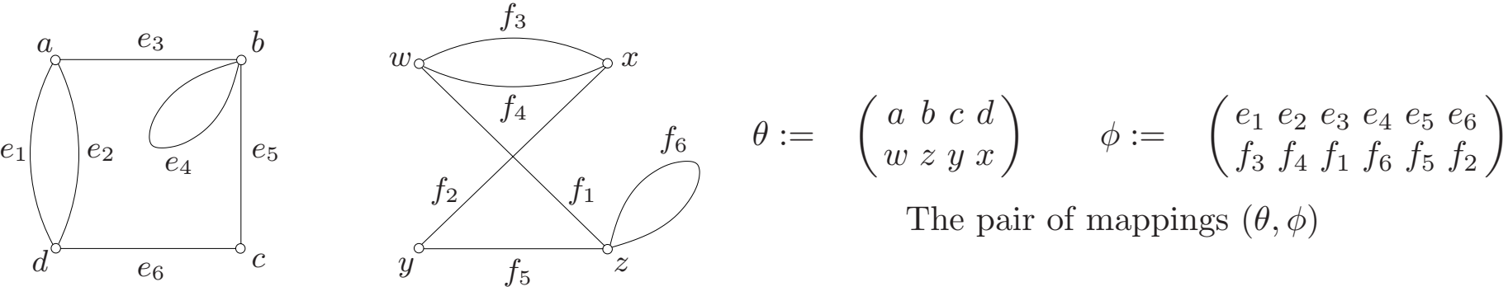

Basics of Graph Theory
Special Families of Graphs
6. Graph Complement
The complement of G = (V, E) is a simple graph $\overline{G}$ = (V, $\overline{E}$), where the edges in are exactly the edges not in G
The complement of the complete graph K_{n} is the empty graph with n vertices
7. Isomorphic Graphs
A graph can exist in different forms having the same number of vertices, edges, and also the same edge connectivity. Two graphs G1 and G2 are said to be isomorphic if:
Same Number of Vertices and Edges
Preservation of Adjacency (If there is an edge between two vertices in one graph, there must be a corresponding edge between the corresponding vertices in the other graph).
Bijection: There must be a bijection between the vertex sets of the two graphs (one-to-one mapping)

Slide 11
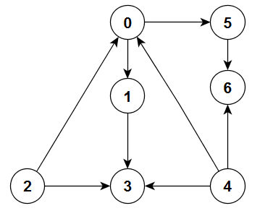
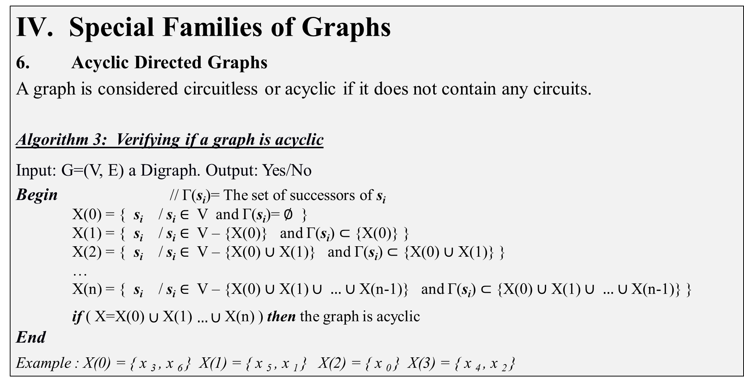
Basics of Graph Theory
Special Families of Graphs
6. Acyclic Directed Graphs
A graph is considered circuitless or acyclic if it does not contain any circuits.
Algorithm 3: Verifying if a graph is acyclic
Input: G=(V, E) a Digraph. Output: Yes/No
Begin // Γ(s_{i})= The set of successors of s_{i}
    X(0) = { s_{i} / s_{i} ∈ V and Γ(s_{i})= $∅$ }
    X(1) = { s_{i} / s_{i} ∈ V – {X(0)} and Γ(s_{i}) $⊂$ {X(0)} }
    X(2) = { s_{i} / s_{i} ∈ V – {X(0) $∪$ X(1)} and Γ(s_{i}) $⊂$ {X(0) $∪$ X(1)} }
    …
    X(n) = { s_{i} / s_{i} ∈ V – {X(0) $∪$ X(1) $∪ …$ $∪$ X(n-1)} and Γ(s_{i}) $⊂$ {X(0) $∪$ X(1) $∪ …$ $∪$ X(n-1)} }
    if ( X=X(0) $∪$X(1) $…∪$X(n) ) then the graph is acyclic
End
Example : X(0) = { x ₃ , x ₆ } X(1) = { x ₅ , x ₁ } X(2) = { x ₀ } X(3) = { x ₄ , x ₂ }

Slide 12
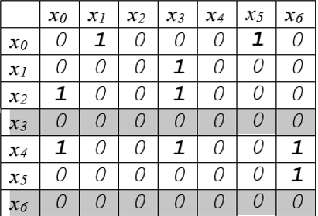
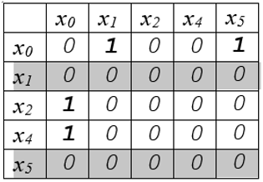
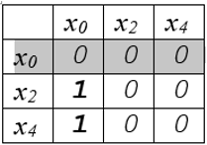
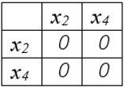
Basics of Graph Theory
Special Families of Graphs
6. Acyclic Directed Graphs
Algorithm 4: Verifying if a graph is acyclic
Input: The adjacency matrix M. Output: Yes/No
Begin
    if ( ∃ a row i contains only 0 ) then
      Delete the row i and the column i
      If (the matrix M contains only 0 ) then
        The graph is acyclic
        Otherwise, Go to
end if
end if
End
1
1

