Slide 1
Chapter 5: Trees
Introduction
Overview
Examples of using trees
Implementation
Binary trees
Binary Search Trees

Slide 2
Introduction
In Array we have:
+ Direct access by index (fast)
- Insertion and deletion require shifting
In linear linked lists we have:
+ Insertion and deletion are done only by chain modification.
- Slow sequential access.
Trees represent a compromise between the two:
+ Relatively quick access to an item.
+ Cost-effective addition and removal.

Slide 3
Introduction
The tree structure is one of the most important and distinctive structures in computer science, enabling the creation of highly efficient algorithms.
Several computer treatments have a tree-structured nature, such as:
The representation of programs processed by a computer,
The representation of a table of contents….
Representation of arithmetic expressions

Slide 4
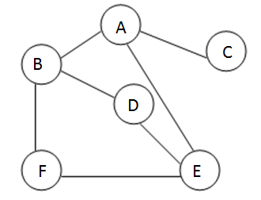
Overview (Definition)
LCraph Concept
A graph G= (S, A) is defined by:
A set of vertices S .
a set of edges A .
Examples of graphs
(cities, roads),
(machines, networks),
TREE: A tree is a non-linear structure, it is a graph without cycles where each node has at most one predecessor .

Slide 5
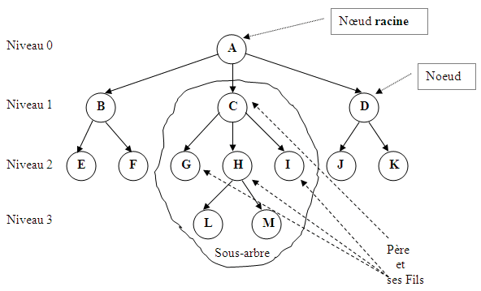
Overview (General notions)
The predecessor, if it exists, is called the father (father of C = A, father of L= H)
The successor, if it exists, is called a child (Children of A = { B,C,D }, Sons of H = { L,M })
The node that has no predecessor is called root (A)
The node that has no successor is called a Leaf (E,F,G,L,J,...)
Descendants of C={G,H,I,L,M}, of B={E,F},...
Ascendants of L={H,C,A }

Slide 6
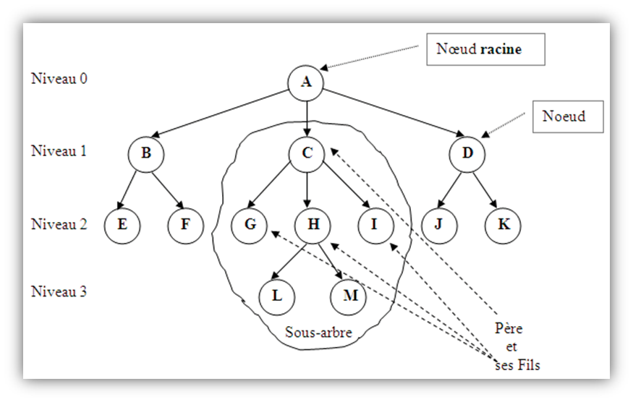
General ( Tree measurements )
Size of a tree: is the number of nodes it has.
Size of this tree = 13
An empty tree has size 0.
Node Level: The level of a node is the number of nodes between it and the root.
Root level = 0
The level of each node is equal to the level of its parent plus 1
Level of E,F,G,H,I,J,K = 2

Slide 7
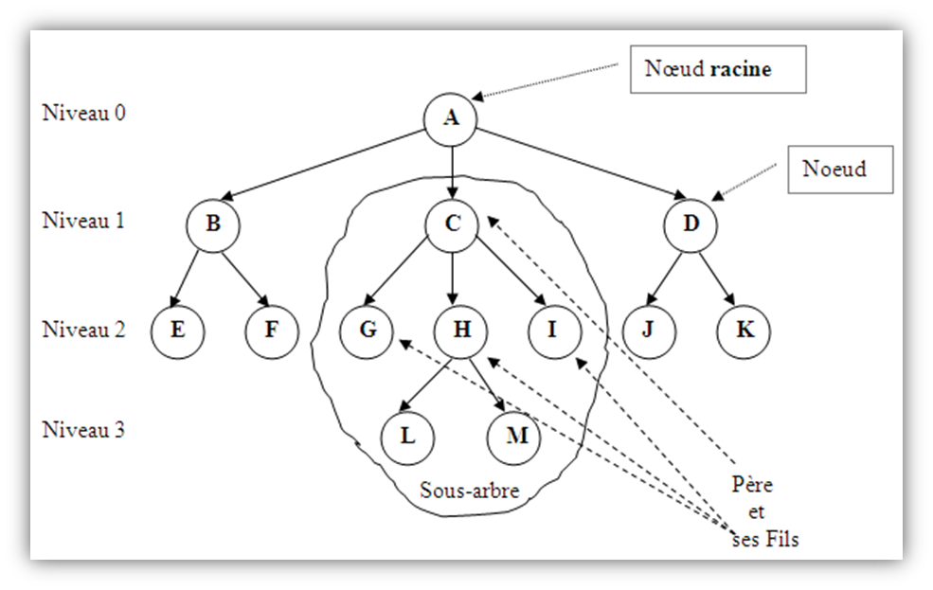
General ( Tree measurements )
Height (Depth) of a tree: the maximum level in that tree.
Height of previous tree = 3
Degree of a node: The degree of a node is equal to the number of its children.
Degree of (A = 3, B = 2, C = 3, E = 0, H = 2,...)
Degree of a tree: is the maximum degree of its nodes.
The previous tree degree = 3.

Slide 8
Generalities (Tree typology)
N-ary tree : An n-ary tree of order n is a tree where the maximum degree of a node is equal to n.
Binary tree: It is a tree where the maximum degree of a node is equal to 2.
Binary Search Tree: This is a binary tree where the key of each node is greater than those of its left descendants, and less than those of its right descendants.

Slide 9
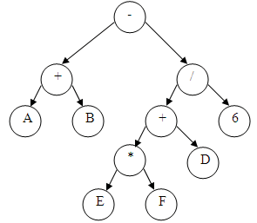
Examples of using trees
Representation of arithmetic expressions:
(A+B) - (E*f + d)/6
Exercise: give the tree representation of the following expressions:
A*B/3-8*C
3*(9-2)+(5-2*8)

Slide 10
Examples of using trees
File representation in Windows.

Slide 11
Examples of using trees
Representation of tables of contents.
Algorithmics and data structures
Linked Lists Stack trees
Static lists DynamicList

Slide 12
Implementation
Trees can be represented by non-linear arrays or lists:
Static representation
Below is the representation of an integer tree by an array:
8
 | element | Son 1 | Son 2
0 | 8 | 1 | 2
1 | 5 | 3 | 4
2 | 3 | 5 | -1
3 | 1 | -1 | -1
4 | 0 | -1 | -1
5 | 7 | -1 | -1
5
3
1
0
7

Slide 13
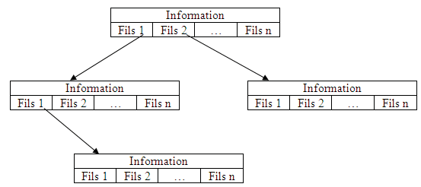
Implementation
Dynamic representation: using a non-linear list where each node contains an element with the list (An array or a list linked) of his sons.
Type definition
Type Structure Node
Ele: typeqq ;
Children: Array[ NbChildren ] of ( *Node );
END ;
Type Tree: * Node;
Element
Element
Element
Element

Slide 14
2. Binary trees

Slide 15
2. 1 definition
Let us consider a set of nodes to which "values" are associated (the elements to be stored: integer, real, structure, etc.). A binary tree can be defined recursively with the following cases:
Empty Tree (NULL): A binary tree can be empty, represented by NULL.
Single Node: A binary tree may consist of only a single node (root).
Root with Left Subtree: A binary tree may have a root node with a left binary subtree attached to it. The right child in this case is NULL.
Root with Right Subtree: A binary tree may have a root node with a right binary subtree attached to it. The left child in this case is NULL.
Root with Both Subtrees: A binary tree may have a root node with both a left binary subtree and a right binary subtree attached to it.

Slide 16
2.2 Implementation
Dynamic representation: using a non-linear list, each node contains an element with the address of its left child (LC) and the address of its right child (RC)
Type definition
Type structure Node :
Ele: Element; // type Element means any type
LC: * Node ; // pointer to left child
RC: * Node ; // pointer to the right child
END ;
Type Tree : * Node ;
element
LC
RC
element
element
NULL
NULL
LC
RC
Element
Element
NULL
NULL
NULL
NULL

Slide 17
2.3 Operations
Create_node function : creates a node containing the value x and without children (LC=NULL, RC=NULL) and returns a pointer to the created node.
Function Create_node​ ( x: Element ): Tree
N:Tree ;
Begin
N ← Allocate ( Node );
N->element ← x;
N-> RC ←NULL ;
N-> LC←NULL ;
Return (N)
END
N
X
NULL | NULL

Slide 18
2.3 Operations
The Content function: returns the content (value) of a node.
Function Content (a: Tree): Element
Begin
Returns (a -> element)
END
Is_empty: Tests whether a tree is empty or not .
Function Is_empty(a: Tree): boolean
Begin
Returns (a=NULL)
END

Slide 19
2.3 Operations
The LeftChild(a: Tree) function: returns the left son of a tree (the left subtree).
Function LeftChild (a: Tree): Tree
Begin
Returns (a- >LC)
END
The RightChild function (a: Tree): returns the right son of a tree (the right subtree).
Function RightChild (a: Tree): Tree
Begin
Returns (a- >RC)
END

Slide 20
2.3 Operations
Is_leaf : Tests whether a node, identified by its address, is a leaf or not.
Function Is_leaf (N: Tree): boolean
Begin
Returns (N!=NULL and LeftChild(N)=NULL and RightChild(N)=NULL)
END
The Size function: returns the number of elements in a tree a.
Function Size (a: Tree): boolean
Begin
if a= NULL then
returns 0;
else return 1 + Size( LeftChild(a)) + Size( RightChild(a));
end if
END

Slide 21
2.4 Traversing a tree
Two deferent approaches:
Depth traversal of a binary tree: includes the following traversal methods:
Preorder Traversal (Root-Left-Right)
Inorder Traversal (Left-Root-Right)
Postorder Traversal (Left-Right-Root)
Breadth-first traversal of a binary tree: explores all the nodes at each depth level of the binary tree before moving on to the next level

Slide 22
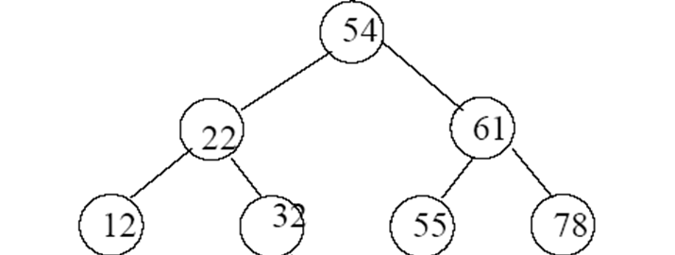
2.4 Path operations
Preorder : The rule of this traversal is very simple: the root of the tree is processed before its descendants.
Procedure Preorder (a: tree)
Begin
If a != NULL then
Write(content(a));
Preorder ( LeftChild(a));
Preorder ( RightChild(a));
Endif
END
Example:
Preorder travarsal of this tree gives: 54 22 12 32 61 55 78

Slide 23
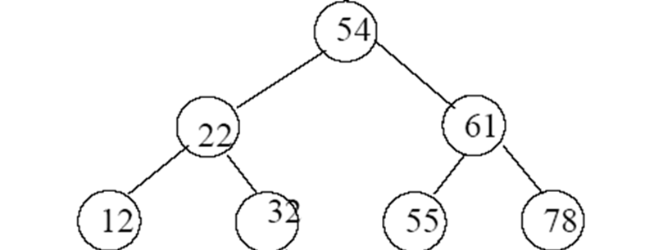
2.4 Path operations
Inorder : The rule of this traversal is as follows: the root of the tree is processed between its descendants.
Procedure Inorder (a: tree)
Begin
If! is_empty(a) then
Inorder ( LeftChild(a));
Write (content (a));
Inorder ( RightChild(a)) ;
Endif
END
Example
Inorder travarsal of the tree A gives: 12 22 32 54 55 61 78

Slide 24
2.4 Path operations
Postorder : The rule for this traversal is as follows: the root of the tree is processed after its descendants.
Procedure Postorder (a: tree)
Begin
If! is_empty(a) then
Postorder ( LeftChild(a));
Postorder ( RightChild(a));
write (content(a));
Endif
END
Example
Postorder travarsal of tree A gives: 12 32 22 55 78 61 54

Slide 25
2.4 Path operations
Breadth-first traversal
All nodes at depth i must have been visited before the first node at depth i + 1 is visited.
Such travarsal requires that one remembers all the branches that remain to be visited.
To do this, we use a queue.
Example:
The Breadth-first traversal
of tree A gives: 54 22 61 12 32 55 78

Slide 26
2.4 Path operations
Breadth-first traversal procedure
Procedure Breadth-first traversal (a: Tree)
F: File
Begin
Initialise(F);
If ! is_empty(a) then
Enqueue (F, a)
While ( ! Is_empty (F) )
write(content(head(F)) );
if ! Is_empty (LeftChild ( head (F)) then
Enqueue (F, LeftChild ( head (F)))
Endif
if ! Is_empty ( RightChild( head (F)) then
Enqueue(F, threadD ( head (F )) )
Endif
Dequeue (F);
End while
Endif
END

Slide 27
2.5 Searching for an element
Function Belongs(x, a) : tests whether x exists in the tree a or not.
Function belong (a: tree, x: typeq ): boolean
Begin
If is_empty (a)) then
return false;
else
If( content(a) = x) then
return true;
else
If belongs (x, LeftChild(a)) then
returns true;
else
return ( belongs (x, RightChild(a)));
Endif
Endif
Endif
END

Slide 28
2.5 Searching for an element
2. The search function: returns the address of the node containing x if x exists in the tree, otherwise it returns NULL.
Function search(a:tree,x: typeq ):tree
P: Tree;
Begin
If is_empty(a) then
P ← NULL;
else
If( content(a) = x) then
return P←a ;
else
P←search ( x, LeftChild(a );
If P = NULL then
P← ( search (x, RightChild(a)));
Endif
Endif
Endif
Return P;
END

Slide 29
2.6 the maximum of a binary tree
the max(a) function: returns the maximum of the tree.
Function max (a:tree ): typeq
m: integer
Begin
m ← content(a)
If ! is_empty ( LeftChild(a )) and ( m < max ( LeftChild(a)) ) SO
m ← max (LeftChild(a ));
Endif
If ! is_empty ( RightChild(a )) and ( m < max ( RightChild(a )) ) SO
m ← max (RightChild(a ));
Endif
return m;
END

Slide 30
a
24
50
60
23
34
17
40
6
80
2
To search for an element in a binary tree we must traverse
all nodes of the tree

Slide 31
3. Binary Search Trees (BST)

Slide 32
a
34
23
60
6
24
50
80
40
2
17

Slide 33
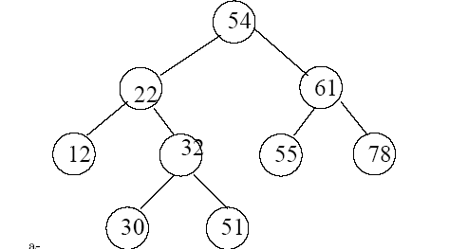
3.1 definition
A binary search tree is a binary tree that satisfies the following property:
let x and y be two nodes of the tree ,
if y is a node in the left subtree of x, then key(y) < key(x),
if y is a node in the right subtree of x, then key(y) > key(x).
HAS

Slide 34
3.2 Operations
Belongs(x, a): This function tests whether x exists in the tree a or not.
Function Belongs (a: Tree, X: Type): boolean
Begin
If is_empty(a) then
return false;
else
If( content(a) = = x) then
return true;
else
If ( x < content(a)) then
return ( Belong (x, LeftChild(a)) ;
else
return ( Belongs (x, RightChild(a));
Endif
Endif
Endif
END

Slide 35
3.2 Operations
Insert (a:Tree, x:Element) using the prefixed traversal it will be very easy to insert new nodes.
Function insert (a: tree, x: type) tree
Begin
if is_empty (a)) then
a ← create_node(x);
else
If ( x < content(a)) then
a -> LC = insert (x, LeftChild(a));
else
a -> RC = insert (x, RightChild(a));
Endif
Endif
return a ;
END

Slide 36
3.2 Operations
Deletion: Deleting a key in a tree is a more complex operation. Several cases are to be considered depending on the number of children of node x:
If the element to be deleted does not exist, nothing is done.
If the element to be deleted has no left child, it is replaced by its right child.
If the element to be deleted has no right child, it is replaced by its left child.
If the element to be deleted has two children, it is replaced by the largest ( respectively smallest) element of its left ( respectively right) subtree .

Slide 37
3.2 Operations
3. Deletion: Three functions cooperate for deleting an element.
The first, delete , searches for the node carrying the key to delete.
Function delete (a: tree, x: type) tree
Begin
If ! is_empty (a)) then
if ( content(a) == x )
a ← deleteRoot (a);
else
If ( x < content(a) )
a -> LC = delete (x, sonG(a));
else
a -> RC = delete (x, sonD(a));
Endif
Endif
Endif
return a;
END

Slide 38
3.2 Operations
the second, deleteRoot , performs the deletion according to the cases listed above.
Function deleteRoot (a:tree)
Begin
If( LeftChild(a) = = NULL )
return RightChild(a) ;
else
If (RightChild(a) = = NULL)
return LeftChild(a) ;
else
a-> Ele = max ( LeftChild(a));
a ->LC = delete (LeftChild(a), max (LeftChild (a)),);
return a ;
Endif
Endif
END

Slide 39
3.2 Operations
The third, Max , returns the largest element in its left subtree.
Function Max (a: Tree) : type
Begin
If (a->RC )= NULL then
return Content (a) ;
else
return max ( RightChild(a)) ;
Endif
END

Slide 40
3.3 Balancing
Consider the following two BSTs:
These two ABRs contain the same elements, but are organized differently. The depth of the first is less than that of the second.
If we are looking for element 10 we will have to go through 3 elements (50, 20, 10) in the first tree, on the other hand in the second, we will have to go through 5 elements (80, 70, 50, 20,10).
The first tree is said to be more balanced.

Slide 41
3.3 Balancing
An ABR is said to be balanced if for any node in the tree the difference between the height of the left subtree and the right subtree is at most equal to 1. It is always advisable to work on a balanced tree to ensure the fastest possible search .
The balancing operation can be done:
Every time a new node is inserted,
Whenever the imbalance reaches a certain threshold to avoid the cost of the balancing operation which requires a reorganization of the tree.

