Slide 1
OUTLINE
1. Introduction
2. Teaching & Learning Processes
3. Definition of Approach, Method and Technique
4. Teaching Approaches:
- Flipped Approach
- Kinesthetic Approach
- Personalized Approach
- Inquiry Approach
- Expeditionary Approach
- Differentiated Approach

Slide 2
INTRODUCTION
1. What is the interest of investigating the teaching and learning process?
2. What is the utility of the approaches to teaching languages?

Slide 3
Teaching and Learning Process
Curriculum
Learning Theories
Materials
Content
Cognition
Student
Teacher
Teaching Methodology
Learning Styles
Needs
Syllabus
Motivation

Slide 4
Language Teaching Approaches/Methods
Approach, Method and Technique
In 1963, Edward Anthony gave a definition that has withstood the test of time.
His concept of “method” is the second of three hierarchical elements, namely approach, method, and technique.
According to Anthony, an approach is a set of assumptions (beliefs) dealing with the nature of language, the nature of learning and teaching.
A method is an overall plan for systematic presentation of language based upon a selected approach.
A technique is the specific activity which takes place in the classroom that is consistent with a method, and therefore in harmony with an approach.

Slide 5
Language Teaching Approaches/Methods
Jack Richards and Theodore Rodgers reformulation of the concept of “method” (1982)
Anthony’s approach, method, and technique were renamed, respectively as, approach, design, and procedure, with a super ordinate term to describe this three-step process, now called “method”.
A method is “an umbrella term for the specification and interrelation of theory and practice” (1985:154).
An approach is assumptions, beliefs, and theories about the nature of language and language learning.
A design is the relationship of the theories to classroom materials and activities including six important features:
objectives,
syllabus (criteria for selection and organization of linguistic and subject-matter content),
activities,
learner roles,
teacher roles,
and the role of instructional materials;
A procedure is the technique and practice that are derived from the approach and the design.

Slide 6
Language Teaching Approaches/Methods
Definitions in Current Usage
Approach: theoretically well-informed positions and beliefs about the nature of language, the nature of language learning, and the applicability of both to pedagogical settings.
Method: a set of classroom specifications for accomplishing linguistic objectives.
It is concerned with:
objectives,
sequencing information,
materials to be used,
and teachers and students roles.
Techniques: exercises, activities, or tasks used in the language classroom in order to realize objectives.

Slide 7
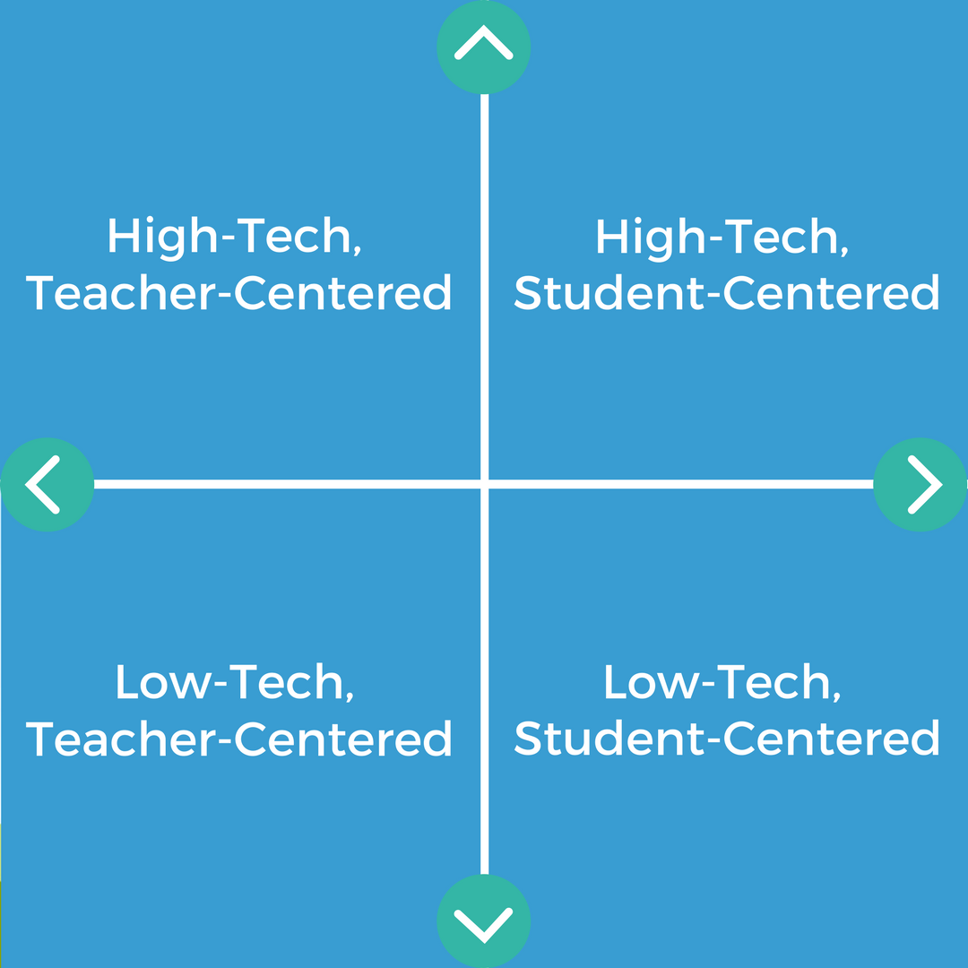
Teaching APPROACHES

Slide 8
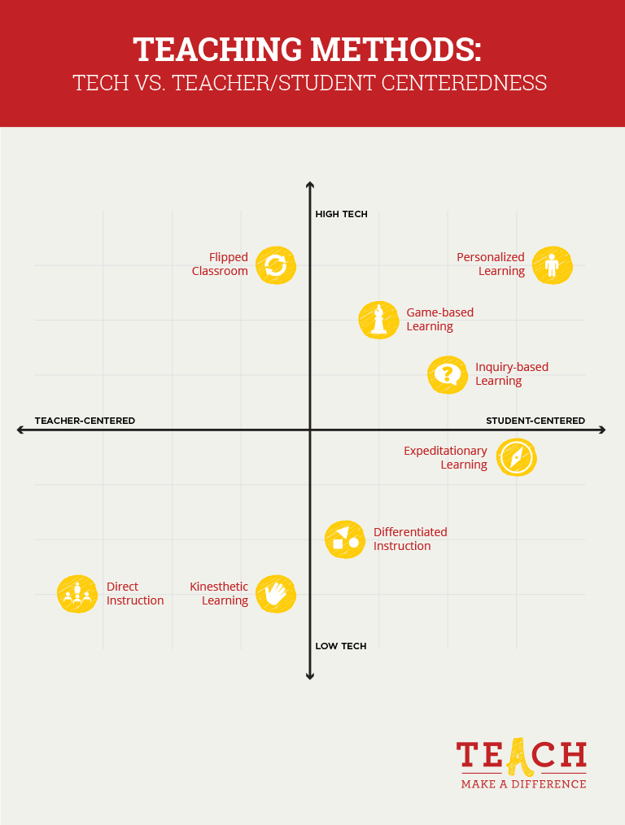

Slide 9
Teacher Centered APPROACHES
Teachers are the main authority figure in a teacher-centered instruction model.
Students passively receive information.
Desired learning is assessed directly through the use of objectively scored tests.
Teaching and assessing are separate.
Emphasis is on right answers.
Only students are viewed as learners…

Slide 10
Learner Centered APPROACHES
Teachers and students play an equally active role in the learning process.
Students are actively involved.
Desired learning is assessed indirectly through papers, projects, performances, portfolios, and the like.
Teaching and assessing are intertwined.
Emphasis is on generating better questions and learning
from errors.
- Professor and students learn together.

Slide 11
Advantages OF A TEACHER CENTERED CLASSROOM
Order in the class! Students are quiet as the teacher exercises full control of the classroom and activities.
Being fully in control minimizes an instructor’s concern that students may be missing key material.
Teachers feel comfortable, confident and in charge of the classroom activities.
Students always know where to focus their attention — on the teacher.

Slide 12
DISADVANTAGES OF A TEACHER-CENTERED CLASSROOM
This method works best when the instructor can make the lesson interesting; absent this, students may get bored, their minds may wander and they may miss key information.
Students work alone, missing potential opportunities to share the process of discovery with their peers.
Collaboration, an essential and valuable skill in school and in life, is discouraged.
Students may have less opportunity to develop their communication and crucial-thinking skills.

Slide 13
ADVANTAGES OF A STUDENT-CENTERED CLASSROOM
Education becomes a more shared experience between the instructor and the students, and between the students themselves.
Students build both collaboration and communication skills.
Students tend to be more interested in learning when they can interact with one another and participate actively in their own education.
Members of the class learn to work independently and to interact with others as part of the learning process.

Slide 14
DISADVANTAGES OF A STUDENT-CENTERED CLASSROOM
With students free to interact, the classroom space can feel noisy or chaotic.
Classroom management can become more of an issue for the teacher, possibly cutting into instructional activities.
With less focus on lectures, there can be a concern that some students may miss important information.
Though collaboration is considered beneficial, this approach may not feel ideal for students who prefer to work alone.

