Slide 1
Language Course Design: Language Teaching Materials & Media
Dr. Oualid Nemouchi

Slide 2
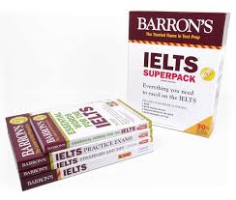
Getting Started
Notes:
The first image that comes to mind

Slide 3
Getting Started
What other kinds of materials can you think of?

Slide 4
In this Class
Definition of Instructional Materials
Classification of Materials
Types of Media
How to Design Teaching Material
A Framework of Materials in Language Courses
Principles of Language Teaching Materials
Adoption, Development and Adaptation
The Importance of Instructional Materials in Teaching Language
References

Slide 5
Definitions
Anything which is used by teachers or learners to facilitate the learning of a language. Tomlinson , 1998, p.2
Any systematic description of the techniques and exercises to be used in classroom teaching. Brown, 1995, p.139
As such, Material encompasses everything from your chalkboard to your classroom blog.

Slide 6
Classification
By Purpose
By Format
By creator
Instructional
Authentic
Paper-based
Audio-visual
Electronic
Commercial
In- house

Slide 7
Types of Media
Visual media: Pictures, board, textbooks, newspapers and magazines, comics, literary works, augmented reality media…
Audio Media: Tape recorder, radio, compact disks…
Audio- Visual Media: Film, television, youtube,…
Notes:
also called Mechanical Aids, Intstructional Materials

Slide 8
How to Design Teaching Materials
1- Establish an objective
2- Analyze the audience
3- Consider differing learning styles
4- Select a delivery method
5- Seek ways to integrate technology
Notes:
Cognitive objective, Behavioral objective.

Slide 9
Framework
Adopting
Decisions on Material
Developing
Adapting
Notes:
Pedagogical or Educational reasons
Private school, private need.

Slide 13
Notes:
.

Slide 17
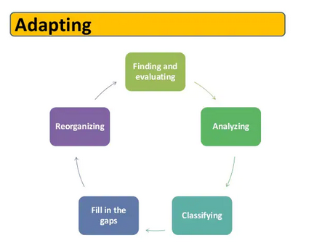

Slide 18
The Importance of Instructional Materials in Teaching Language
Make learning more interesting, practical, realistic and appealing.
enable both the teachers and students to participate actively and effectively in lesson sessions.
give room for acquisition of skills and knowledge and development of self- confidence and self- actualization.
important for practical and demonstration in the class situation by students and teachers.
devices that assist the teacher to present a lesson to the learners in a logical manner.
appeal to the sense organs during teaching and learning.
make learning of subject matter understandable to students during teaching learning process.
asserted that non availability and inadequacy of instructional materials are major causes of ineffectiveness of the school system and poor performance of students in schools.

